Slide 1
Algorithm Design
State machines

Slide 2
State Machine Recap
Let us explore a simple lift door operation with a switch by building a state machine
S1
S2
S1: Door Closed State
S2: Door Open State
Door Closed
Door open

Slide 3
State Machine Recap
Let us explore a simple lift door operation with a switch by building a state machine
S1
S2
S1: Door Closed State
S2: Door Open State
Door Closed
Door open
The Lift Door opens only when you press the switch
E1
S1
S2
S1: Door Closed State
S2: Door Open State
Press
Switch
E1: Press Switch Event
Door Closed
Door open

Slide 4
State Machine Recap
E1
Open
Switch
S1
S2
S1: Door Closed State
S2: Door Open State
Close
Switch
E1: Press Open Switch Event
E2
E2: Press Close Switch Event
Door Closed
Door open

Slide 5
State Machine Recap
E1
Open
Switch
S1
S2
S1: Door Closed State
S2: Door Open State
Close
Switch
E1: Press Open Switch Event
E2
E2: Press Close Switch Event
Door Closed
Door open
Introducing an intermediate stage of opening and closing
E1
E3
Open
Switch
S1
S2a
S2
Close
Switch
Door Closed
Door
Opening/closing
Door open
E4
E2
S1: Door Closed State
E1: Press Open Switch Event
S2: Door Open State
E2: Press Close Switch Event
S2a: Door Intermediate State
E3: Door open complete
E4: Door close complete

Slide 6
State Machines - Recap
Open
Switch
Close
Switch
Door Closed
Door
Opening/closing
Door open
E1
E3
S2a
S1
S2
E5
Think of more states and events
S2b
E6
E4
E2
S1: Door Closed State
E1: Press Open Switch Event
E5: Door obstruction
S2: Door Open State
E2: Press Close Switch Event
E6: Door Open Period Timeout
S2a: Door Opening State
E3: Door open complete
S2b: Door Closing State
E4: Door close complete

Slide 7
State Machines Recap
E1
E3
S2a
S1
S2
E5
S2b
E6
E4
E2
S1: Door Closed State
E1: Press Open Switch Event
E5: Door obstruction
S2: Door Open State
E2: Press Close Switch Event
E6: Door Open Period Timeout
S2a: Door Opening State
E3: Door open complete
S2b: Door Closing State
E4: Door close complete
Actions to be taken on occurrence of event
E1: Press Open Switch Event
A1: Switch-on Door-opening Motor
A2: Start Door Open Complete Sensing
E3: Door Open Complete
A3: Switch-off Door-opening Motor
A4: Stop Door Open Complete Sensing
E2: Press Close Switch Event
A5: Switch-on Door-closing Motor
A6: Start Door Close Complete Sensing
E4: Door Close Complete
A7: Switch-off Door-closing Motor
A8: Stop Door Close Complete Sensing
E5: Door Obstruction
A7, A8, A1, A2

Slide 8
State Machines Recap
State Machine Table
E1
E3
Current state | Event | Action | Next State
S1 | E1 | A1,A2 | S2a
S2a | E3 | A3,A4 | S2
S2 | E2,E6 | A5,A6 | S2b
S2b | E4 | A7,A8 | S1
S2b | E5 | A7,A8,A1,A2 | S2a
S2a
S1
S2
E5
S2b
E6
E4
E2
S1: Door Closed State
E1: Press Open Switch Event
E5: Door obstruction
S2: Door Open State
E2: Press Close Switch Event
E6: Door Open Period Timeout
S2a: Door Opening State
E3: Door open complete
S2b: Door Closing State
E4: Door close complete
Actions to be taken on occurrence of event
E1: Press Open Switch Event
A1: Switch-on Door-opening Motor
A2: Start Door Open Complete Sensing
E3: Door Open Complete
A3: Switch-off Door-opening Motor
A4: Stop Door Open Complete Sensing; Start Timer1
E2: Press Close Switch Event
A5: Switch-on Door-closing Motor;
A6: Start Door Close Complete Sensing; Stop Timer1
E4: Door Close Complete
A7: Switch-off Door-closing Motor
A8: Stop Door Close Complete Sensing
E5: Door Obstruction
A7, A8, A1, A2;
Think - What should happen when events not shown in the diagram/table occur???

Slide 9
State Machine Recap
Implementation option based on current state and event ocurrence
If then else
Switch case
State table based transitioning
Create a state machine handler to avoid blocking (?)

Slide 10
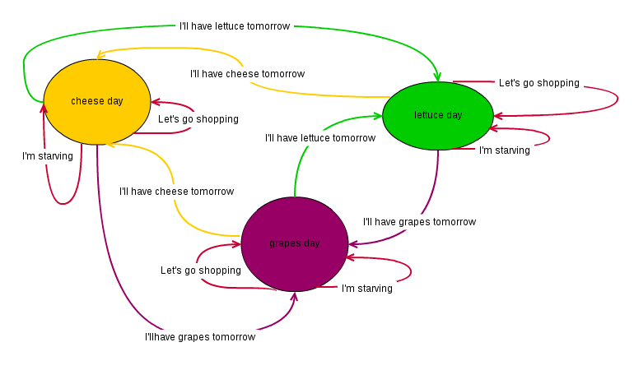
Let us think algorithm
Assignment2
Develop an Algorithm for the following state machine

Slide 11
Let us think algorithm
Let us first collect all the data for building this algorithm.
What are the various states?
What are the various events?
What are the transitions?
Create the state table
Choose an option and create the algorithm that meets all the given inputs

